Slide 1
Quantifying the need for comprehensive hearing care and loss prevention.
“Those with hearing loss are more likely to have low employment rates, lower worker productivity, and high healthcare costs.”
“The number of people living with unaddressed hearing loss and ear diseases is unacceptable. Timely action is needed to prevent and address hearing loss…”

Slide 2
#3
Chronic Condition
Hearing loss is the 3rd most common chronic physical condition, and 2x as prevalent as diabetes, cancer or vision loss.
If you’re not
protecting your hearing,
you’re losing it.
1.5 Billion
people ages 12-35 are at risk of permanent, avoidable noise-induced hearing loss due to unsafe​ listening.
50M
Americans have hearing issues
Suffer from Tinnitus (ringing in the ears). Tinnitus has a negative impact on quality of life, similar to chronic daily headache and low back pain.
1 in 4
Working-age
adults
60%
Of hearing loss cases are considered preventable, and yet:
4 of 5 people report never/seldom wearing hearing protection at loud events
50% of noise exposed workers report not wearing hearing protection on the job
are working age
60%
Preventable
Notes:
Hearing loss is the 3rd most common chronic physical condition in the US and is 2x as prevalent as diabetes or cancer Link here
Millions of teenagers and young people are at risk of hearing loss due to unsafe use of personal audio devices and exposure to damaging sound levels at venues such as nightclubs, bars, concerts and sporting events (WHO) Link Here
- 60% of cases of hearing loss are considered preventable Link here

Slide 3
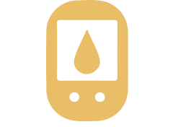
Hearing Loss Comorbidities in Adults
Hearing loss is a modifiable determinant of health & wellbeing
CANCER
DEPRESSION
52-72% of cancer patients have measurable hearing loss and approximately 40% have tinnitus. Obtaining baseline hearing tests and monitoring for ototoxicity during and after treatments can assist with improving patient quality of life.
Hearing Impairment (both self reported and audiometrically detected) is significantly associated with depression in adults 18+ and higher use of mental health services. Hearing loss is also associated with developing severe loneliness.
DIABETES
CARDIOVASCULAR DISEASE
Diabetics are 2X more likely to have hearing loss (pre-diabetics are 30% more likely) and they have 70% higher vestibular dysfunction with 39% higher incidence of falls.
Cardiovascular risk factors and disease are associated with greater hearing loss and a faster rate of hearing deterioration.
KIDNEY DISEASE
COGNITIVE IMPAIRMENT OR DEMENTIA
Hearing loss is common among older adults with chronic kidney disease, both syndromic and nonsyndromic.⁹
Addressing hearing loss in midlife is the largest modifiable risk factor for dementia. Hearing loss has been associated with cognitive decline and is more prevalent in adults with dementia and/or Alzheimer’s Disease than those with no memory issues.
FALLS
Even mild hearing loss 3X the risk of accidental fall; for every additional 10 dB of loss, the risk of fall increases by 140%
Notes:
SOURCES 1. U.S. Department of Health and Human Services. National Institutes of Deafness and Other Communication Disorders. (2016) https://www.nidcd.nih.gov/health/statistics/ quick-statistics-hearing. 2. Paken J, Govender CD, Pillay M, Sewram V. (2016) Cisplatin-associated ototoxicity: A review for the health professional. J Toxicol 1809394. 3. Li C, Zhang X, Hoffman HJ, Cotch MF, Themann CL, Wilson MR. (2014) Hearing impairment associated with depression in US adults, national health and nutrition examination survey 2005–2010. JAMA Otolaryngol Head Neck Surg. 140(4):293–302. 4. Friedland DR, Cederberg C, Tarima S. (2009) Audiometric pattern as a predictor of cardiovascular status: Development of a model for assessment of risk. Laryn 119:473–486. 5. Horikawa C, et al. (2013) Diabetes and risk of hearing impairment in adults: A meta-analysis. J Clin Endocrinol Metab 98(1):51–58. 6. Lin SW, Lin YS, Weng SF, Chou CW. (2012) Risk of developing sudden sensorineural hearing loss in diabetic patients: a population-based cohort study. Otol Neurotol 33(9):1482–1488. 7. Jayakody DMP, Friedland PL, Martins RN, Sohrabi HR. (YEAR) Impact of aging on the auditory system and related cognitive functions: A narrative review. Front Neurosci. 8. Uhlmann RF, Larson EB, Rees TS, Koepsell TD, Duckert LG. (1989) Relationship of hearing impairment to dementia and cognitive dysfunction in older adults. JAMA, 261(13):1916–1919. 9. Vilayur Eswari, et al. (2010) The Association Between Reduced GFR and Hearing Loss: A Cross-sectional Population-Based Study. Amer J Kid Dis 56(4):661–669. 10. Lin FR, Ferrucci L. (2012) Hearing loss and falls among older adults in the United States. Arch Intern Med 172(4):369–371.

Slide 4
Why Should Employers Care?
Those with hearing loss are more likely to have low employment rates, lower worker productivity, and high healthcare costs.
HEARING LOSS IS A MODIFIABLE DETERMINANT OF HEALTH & WELLBEING
3rd most common chronic physical condition in the USA 2x more prevalent than diabetes, cancer, or vision loss
Diabetics:
- 2x more likely to have hearing loss
- 70% higher vestibular dysfunction & 39% higher incidence of falls
3x higher risk of accidental fall for anyone with mild hearing loss;
140% increase in risk of falling for every +10 dB of loss 52-72% of cancer patients have measurable hearing loss and approximately 40% have tinnitus.
Cognitive decline & dementia are associated w/ hearing loss
Mental Health Impact: Hearing impairment is significantly associated with depression in adults 18+ and higher use of mental health services. Increased loneliness: odds for severe/very severe loneliness significantly increases by 7% for every dB SNR reduction $154 billion annual cost of loneliness to employers, and it substantially contributes to worker job-withdrawal and has negative implications for organizational effectiveness and costs. Hearing aid use reduces the risk of cognitive decline by 48% & significantly decreases perceptions of loneliness
Notes:
dementia & Alzheimer’s

Slide 5
Gap in Care
There is no hearing benefit available that includes preventive hearing care & education, or support for those with mild to moderate hearing loss, Tinnitus, APD and other hearing complications. Major medical covers issues with the physical ear or surgical intervention, not hearing.
Legacy Hearing Aid Rider
Almost 40% of employers offer a rider hearing benefit (i.e. discount hearing aid program), but these programs are manufacturer specific, are limited, require heavy out-of-pocket costs and only support those with significant loss.
They don’t include preventive care, or support for mild-moderate loss.

Slide 6
Tuned - vs - Legacy Hearing Aid Benefits
Tuned is the only comprehensive hearing benefit available offering support from prevention to intervention!
Tuned
vs
Legacy HA
Benefit
Preventive Hearing Screenings & Consultations Annually for Everyone
Supports Full Spectrum of Hearing
(mild & moderate too, not just significant loss)
Support for Hearing Complications like Tinnitus & APD (education/software)
Accessed Virtually - No Commuting or Time Off Work
Offers Range of Rx Hearing Instruments – Brand Agnostic
Offers FDA Approved
Over-The-Counter Solutions
Cost Effective for Member & Employer
No Co-Pays or Out of Pocket Costs
The Hearing Care Benefit

Slide 7
Tuned Aligns with Key Business Initiatives
ADDRESSES A GAP IN CARE related to our hearing, annual preventive care, and hearing education
PROACTIVE PREVENTION: Just like an annual physical, vision, dental and age/gender related preventive measures, our hearing needs annual screenings and preventive care. Tuned helps to avoid further costs resulting from hearing loss and its broader impact to health and productivity.
COMORBIDITY W/ COST DRIVERS: Hearing loss is prevalent and is associated with costly conditions like cardiovascular disease, diabetes, cancer, depression, falling and dementia.
REDUCE FINANCIAL BURDEN: Tuned doesn’t require out of pocket costs, saving employees who needing a device thousands of dollars they otherwise can’t afford. Tuned helps to avoid other costs to the plan or productivity losses by educating employees on ways to conserve their hearing and prevent loss.
EMPLOYER OF CHOICE: Proactively offering innovative support for a permanent, yet avoidable condition that impacts one of our 5 core senses. This will most impact and resonate with the “headphone generation(s)”.
DE&I ALIGNED: Inclusive benefit for all to help prevent an invisible disability, while offering accommodations for employees with hearing difficulties

Slide 8
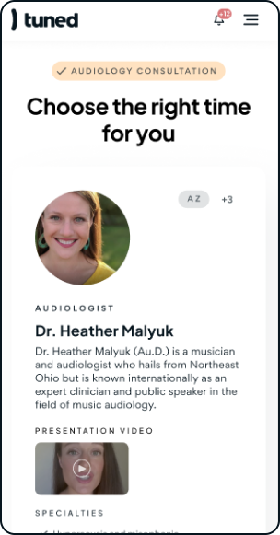
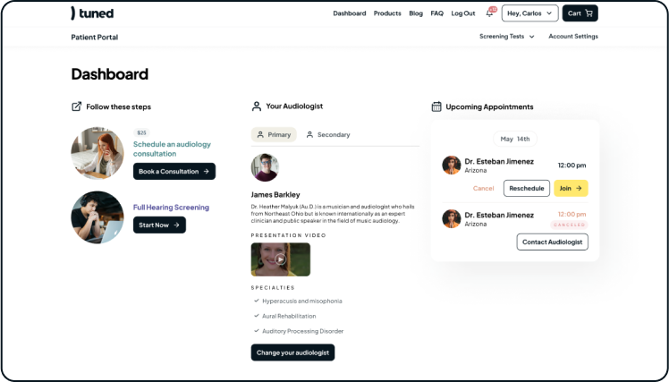
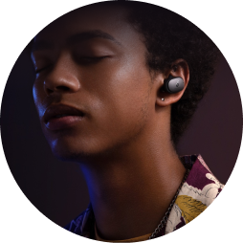
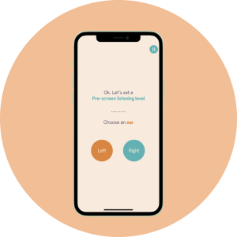
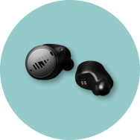
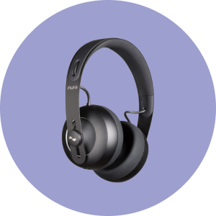
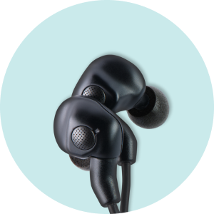
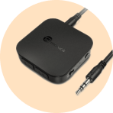
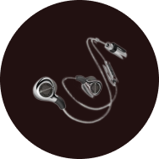
The Solution:
The only comprehensive hearing program available for over 1.4M+ members (and counting!)
Notes:
200% growth in client accounts just since

Slide 9
What is Tuned?
The only online hearing health platform, led by the largest group of audiologists in the US, that supports the entire continuum of hearing care, from prevention to intervention.
Our mission
To make hearing care a standard employee benefit – just like medical, dental, and vision.

Slide 10
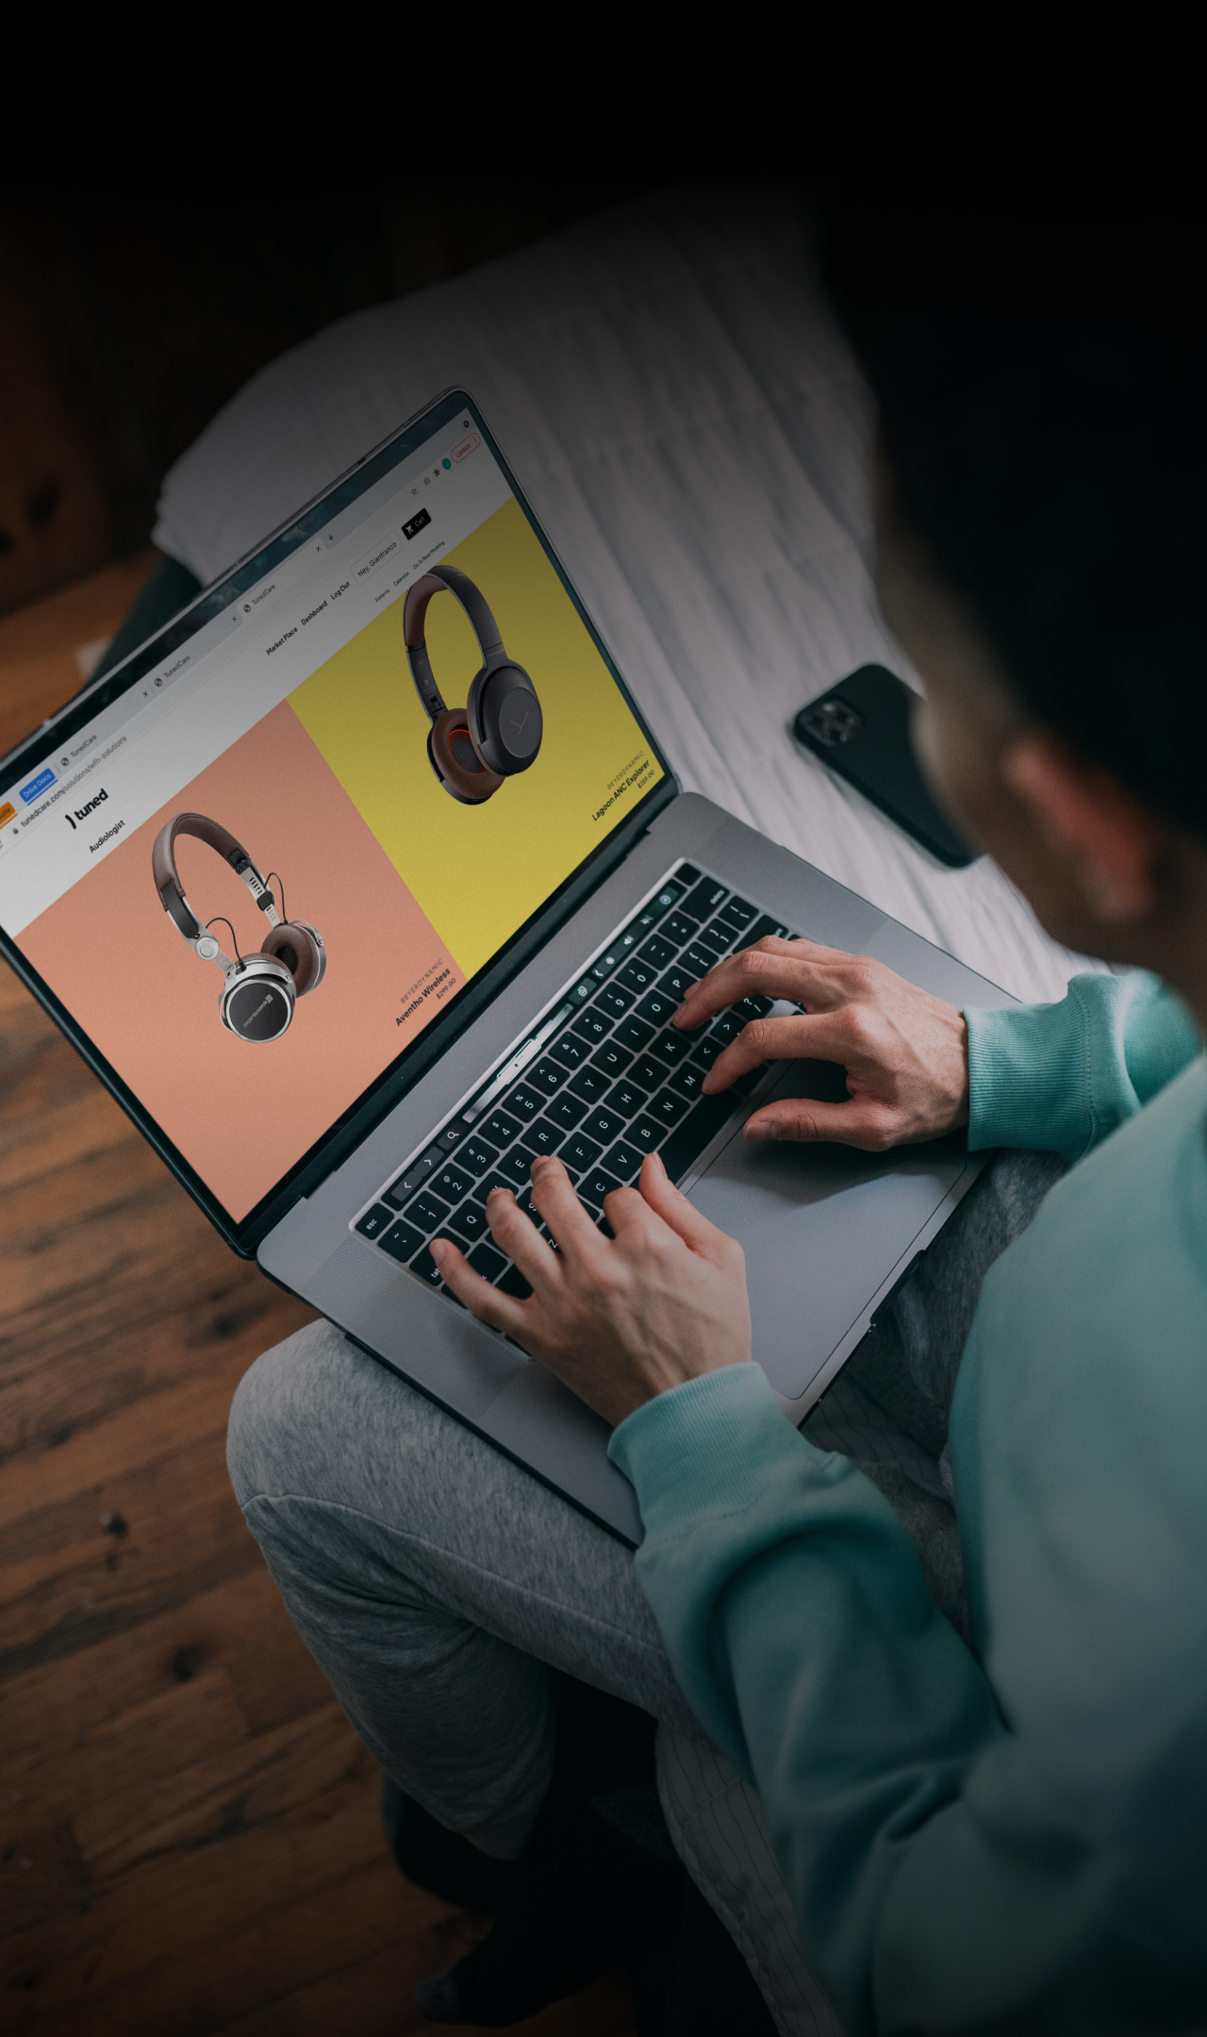
THE TUNED SOLUTION
1
2
3
SCREENING
CONSULTATION
SOLUTIONS
Virtual & Clinically Validated Hearing Screening
Virtual Audiologist Consultation
From hearing aids to helpful apps, we’ve got you covered
Provide guidance and education on how to prevent loss, protect and conserve your hearing, manage tinnitus or auditory processing disorder, and get support for any stage of hearing loss!
Takes 10-15 minutes.
Done anywhere, at anytime, with regular headphones or earbuds.
Includes personalized recommendations and the device or application needed to meet the unique needs of those with a hearing complication or loss.

Slide 11
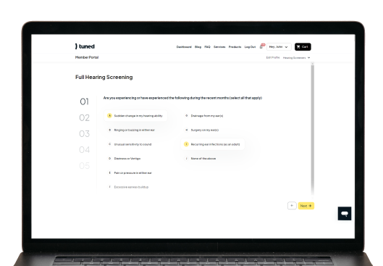
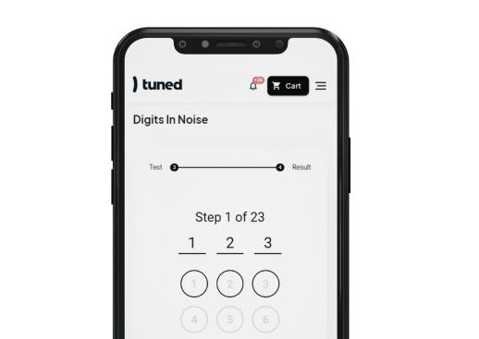
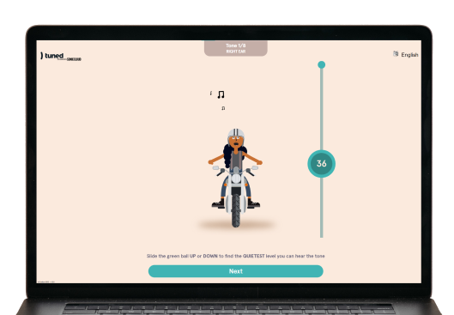
Screening
Complete a brief questionnaire, followed by a two part, clinically validated hearing screening. It’s completed online in 10-15 minutes using regular earbuds or headphones.​
1.
2.
3.
Questionnaires
Digits-In-Noise Screener
Pure Tone Screener
A short series of important questions regarding your hearing history as it relates to your health and wellbeing.
Assess how well you hear digits in the presence of background noise.
Assess your threshold of hearing, determining the softest point at which you hear different pitches.

Slide 12
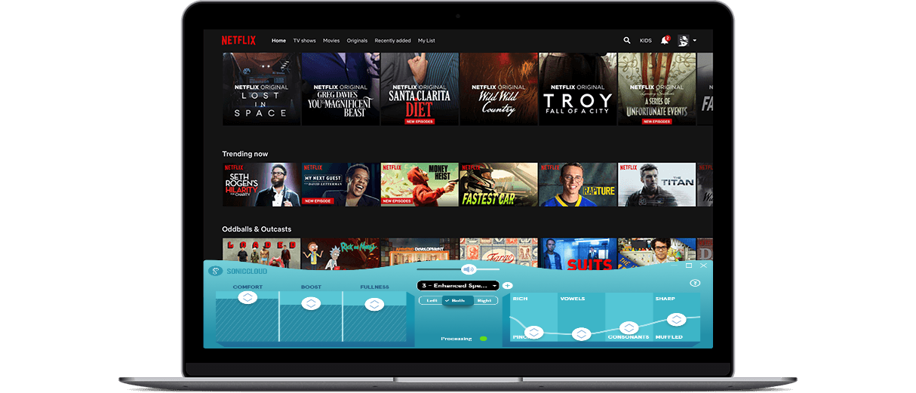
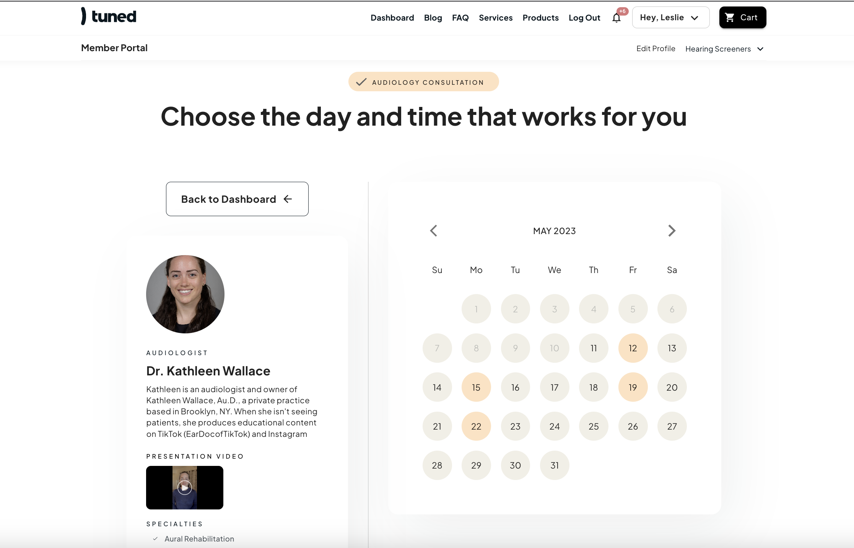
2
Consultation
Online consultation with an audiologist who will review screening results, understand the members unique needs, and provide education and guidance.
All of our Audiologists have:
their AuD (doctor of Audiology)
a valid state audiology license in good standing
a National Provider Identifier (NPI).
Consultation includes:
Review of screening results & meaning
Ways to conserve and protect hearing
Suggestions for improving work calls, managing their Tinnitus or APD
Help adapting any existing devices (like airpods) to their unique needs, or selecting a new device
Assistance navigating the medical benefit and finding a specialist

Slide 13
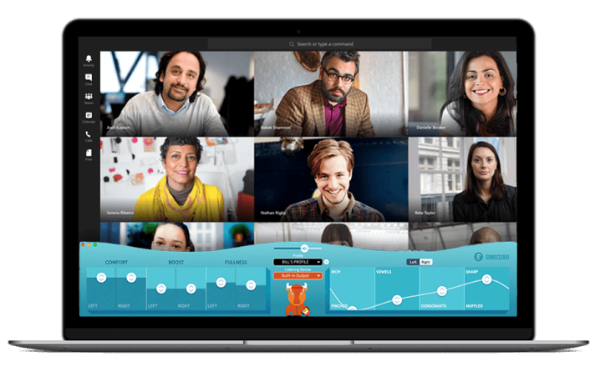
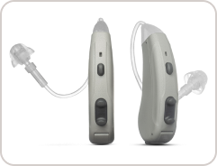
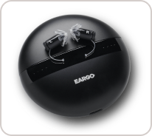
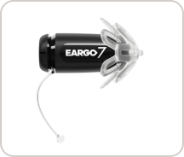
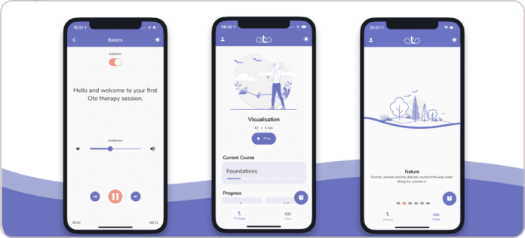
Solutions
Products or services are recommended based on the members unique needs, screening results and consultation. There are dozens of new hardware and software solutions for a myriad of hearing issues, all vetted by Tuned’s audiologists and offered as part of the program!​

